Slide 1
Tree Traversal

Slide 2
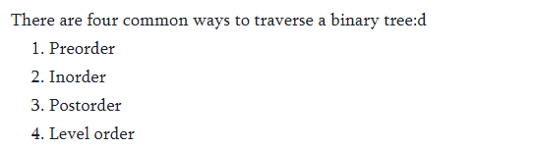

Slide 3
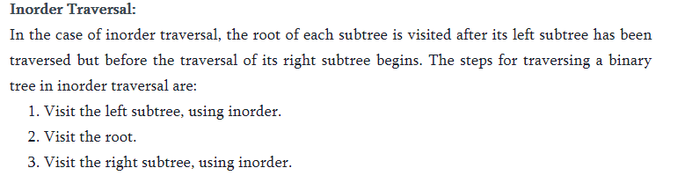
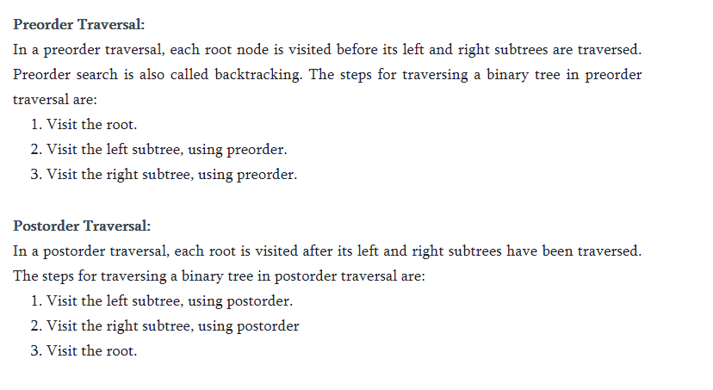

Slide 4
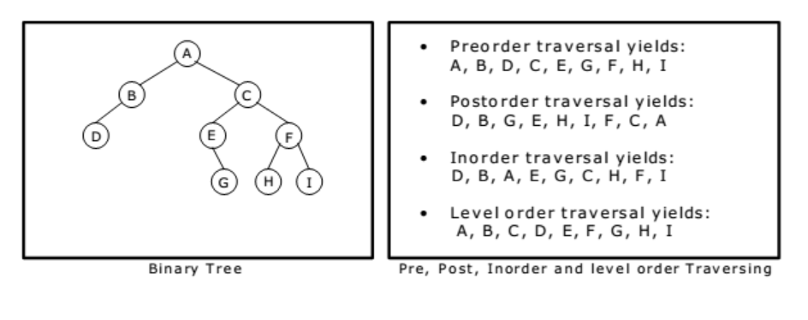

Slide 5
Arithmetic Expression Using BT
+
inorder traversal
A / B * C * D + E
infix expression
preorder traversal
+ * * / A B C D E
prefix expression
postorder traversal
A B / C * D * E +
postfix expression
level order traversal
+ * E * D / C A B
*
E
*
D
/
C
A
B

Slide 6
Inorder Traversal (recursive version)
void inorder(tree_pointer ptr)
/* inorder tree traversal */
{
if (ptr) {
inorder(ptr->left_child);
printf(“%d”, ptr->data);
indorder(ptr->right_child);
}
}
A / B * C * D + E

Slide 7
Preorder Traversal (recursive version)
void preorder(tree_pointer ptr)
/* preorder tree traversal */
{
if (ptr) {
printf(“%d”, ptr->data);
preorder(ptr->left_child);
predorder(ptr->right_child);
}
}
+ * * / A B C D E

Slide 8
Postorder Traversal (recursive version)
void postorder(tree_pointer ptr)
/* postorder tree traversal */
{
if (ptr) {
postorder(ptr->left_child);
postdorder(ptr->right_child);
printf(“%d”, ptr->data);
}
}
A B / C * D * E +

